Slide 1
Designing Effective
EHR Alerts

Slide 2



Why build alerts into the EHR?
Quiz: Which type of system has been found to have the lowest number of errors? Select one of the images below.
Human-led systems
Human-machine systems
Machine-led systems

Slide 3
Why build alerts into the EHR? The answer
Quiz: Which type of system has been found to have the lowest number of errors? Select one of the images below.
Human-led systems
Human-machine systems
Machine-led systems

Slide 4
Topics: Designing effective EHR Alerts
Introduction to EHR Alerts
Five Rights of Clinical Decision Support
Scenarios and EHR Alert design
Champions for Change and their roles

Slide 5
Introduction to EHR Alerts

Slide 6
Introduction to EHR Alerts and their impact
Most Electronic Health Records (EHRs) can display alerts and reminders to end users.
Numerous studies have evaluated use of EHR Alerts and how they impact the way clinical care is delivered.
When EHR Alerts are well designed,
they can positively impact patient care by
helping personnel make appropriate decisions.

Slide 7
EHR Alerts as CDS
EHR Alerts are a form of Clinical Decision Support (CDS) and include technology-mediated:
  reminders
  advisories
  alerts
They have been used to reduce HAI prevalence.
Poorly designed alerts contribute to alert fatigue and overload.
Effective EHR Alerts require collaborative efforts before, during and after their design.

Slide 8
Humans and machines together
When humans and machines work together, they create the most resilient systems.
Researchers note that systems in which humans or computers make decisions without the benefit of the other can result in outcomes that are less than ideal.
  Humans are imperfect, particularly during complex or stressful situations.
  Machines are imperfect, particularly because they are unable to gather the nuance of the human experience.

Slide 9
Working together to reduce HAIs
EHR Alerts are one way in which humans and machines can work together to reduce HAIs.
EHR Alerts are tools that can support clinicians in making evidence-informed decisions in the care of patients.
A well-designed alert can result in improved outcomes.
A poorly designed alert can not only yield poor outcomes, but it can also impact the outcomes of the well-designed ones.

Slide 10
Five Rights of Clinical
Decision Support

Slide 11
The Five Rights of Clinical Decision Support framework
The Five Rights of Clinical Decision Support framework focuses on improving medication use through the use of CDS systems.
The Five Rights can be used to design effective EHR Alerts.
The Five Rights are:
The right information
To the right person
In the right intervention format
Through the right channel
At the right time in the workflow

Slide 12

The right information
An EHR Alert should be:
  evidence-based,
  derived from a set of recognized guidelines, or
  based on a national performance measure
When EHR Alerts derive from lower-quality evidence:
  implementation can be contentious
  they may undermine trust in alerts

Slide 13

To the right person
EHR Alerts should be directed to those with the minimum licensure required to address the alert.
Designing EHR Alert protocols can change care team roles.
Team-based alerts can seem like a good idea, but they can contribute to alert fatigue.

Slide 14

In the right intervention format
Each EHR Alert delivery format offers different behavioral nudges.
Effective EHR Alert design requires that implementers:
  understand what formats are in their arsenal
  understand the potential impact on clinical workflow
  take those into account when selecting the right tool for the problem

Slide 15
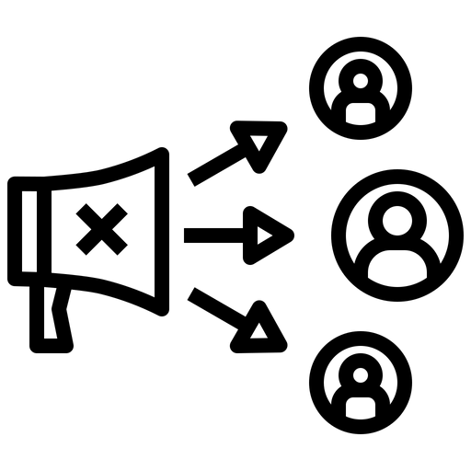
Through the right channel
EHR Alerts are often associated with other systems.
Effective alerts do not need to be limited to the EHR.
The goal of an alert is to raise awareness on the right technology to make a difference.

Slide 16

At the right time in the workflow
One of the hardest parts of building effective EHR Alerts is mapping them into the workflow.
  Building an alert can change the workflow itself.
  Designers have to be sensitive to the timing to ensure the alert is presented in a context-aware form.
Timing can mean time in the process or time in the day.

Slide 17
Scenarios and EHR Alert design

Slide 18
Scenario: Alerting too late in the process
A physician is trying to prescribe a medication that interacts with the patient’s existing medications. The alert only appears after entering the pertinent information for the prescription, when the physician attempts to send the script to the pharmacy. An appropriately timed alert would present as soon as the medication is selected. Later alerts mean wasted effort.
Can you offer an example that you have experienced of when alerts came too late in the process?

Slide 19
Scenario: Alerting too late in the day
A reminder to remove a Foley might be triggered for only one shift to isolate responsibility and ensure the question is asked at a time when the appropriate clinical team is available to make that decision.
Can you offer an example that you have experienced of when alerts came too late in the day?

Slide 20
Health technology tension
A common tension is between the desire to introduce new technology and its impact on clinical processes.
During EHR Alert design, the goal should be for the alert to deploy at the point where the least amount of effort is wasted.
Individuals designing alerts should do so with:
  emotional intelligence
  the input of the planned recipients of the alert
  particular attention to ensuring the clinician recognizes their responsibility to make the decision

Slide 21
Monitoring EHR Alerts
EHR Alerts should be monitored to assess their impact and value, both quantitatively and qualitatively.
If an alert triggers too many irrelevant interventions, the designer may need to redesign the alert’s scope.
The designer must be cognizant of unintended consequences of the alert’s design.
Successful EHR Alerts should be celebrated.

Slide 22
Champions for Change and their roles

Slide 23
Champions for Change:
Frontline Managers
Play a crucial role in ensuring an alert is well-received
Serve as clinical practice champions, educators, and clinical advocates to the designers
Are responsible for providing feedback about the way an alert is implemented by using the Five Rights to express how they are or are not met in practice

Slide 24
Champions for Change:
Infection Preventionists
Reducing HAIs to zero is the mission of every Infection Preventionist.
Have specialized knowledge about HAIs, as well as site-specific knowledge about the hospital itself
Play a critical role in the identification, design and evaluation of effective EHR Alerts
Have a particular responsibility to identify and follow the evidence to guide clinical practice

Slide 25
Champions for Change:
Clinical Leaders
Play a critical role in ensuring the message is heard – that the organization places a premium on reducing HAIs and that EHR Alert adaptation is simply part of the process
Identify goals, consider current evidence and best practices, create and test solutions, heighten awareness, and facilitate acceptance

Slide 26
Champions for Change:
Administrative Leaders
Provide material and organizational support, delegate authority and remove obstacles
Can signal that it’s OK to invest time and talent in figuring out what is going to work
Create partnerships with the organization’s Information Technology department and leadership to execute effective alerts
Administrative Leaders can become EHR Alert design champions

Slide 27
The key takeaway is ...
Designing an effective EHR Alert is a team effort – well worth it because it improves patient outcomes.

Slide 28
Concluding information
The research and development of this toolkit were funded by the Agency for Healthcare Research and Quality [Grant# R01HS024958].
If you would like further information about this study, or would like to participate in future research studies, please contact the SMART Principal Investigator, Dr. Ann McAlearney, at ann.mcalearney@osumc.edu.

